Slide 1
Bocuse INTERNATIONAL
Erasmus Project

Slide 2
Our summary
Today, and for your own pleasure, the Bocuse INTERNATIONAL presents you its new project for this restaurant
First, our servers will bring you the topic of this restaurant
Then, the manager will explain you the tasks distribution
Next, our four cooks will prepare you a good menu
Finally, we gonna expose you the budget of this new project

Slide 3
Our theme: the international Trendy food

Slide 4
Advertisement:
Anne S, Lilia J, Kamil R
Decoration: Soline B, Jean M, Loan G, Louis C
Task distribution
Cooking: Olga R, Natalia S, Lydia V, Lilia J, Agnès V
Presentation:
Everybody

Slide 5
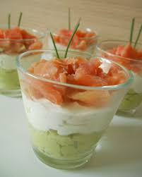
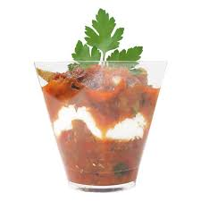
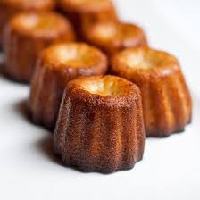
Menu français
Verrine au saumon, avocat et crème fraîche
Salmon jack, avocado and fresh cream
Verrine ratatouille, yaourt et menthe
Jack ratatouille, yogurt and mint
Cannelés bordelais
Little caramelized cakes

Slide 6
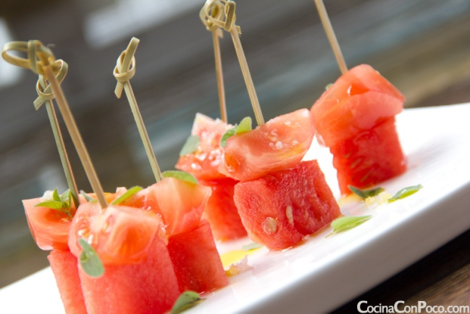
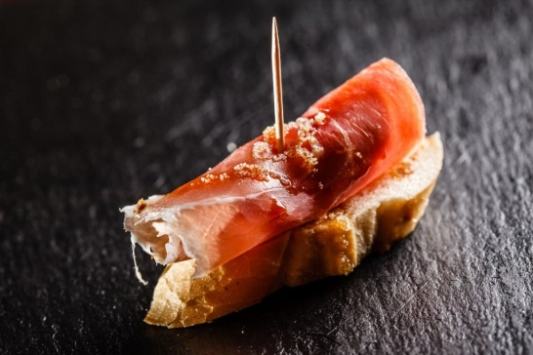
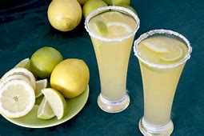
Spanish food
Tapas con jamón y sandía
Tapas with ham and watermelon
Limonada
Lemonade

Slide 7
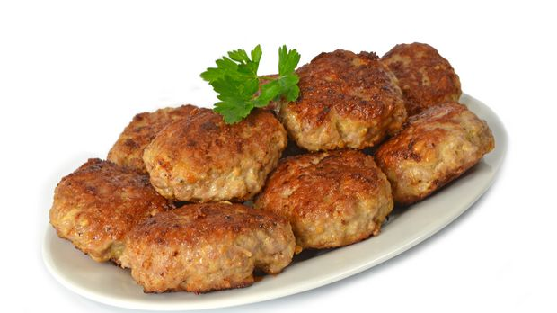
German food
Frikadellen
Frikadella
Apfelschorle
Apple spritzer

Slide 8
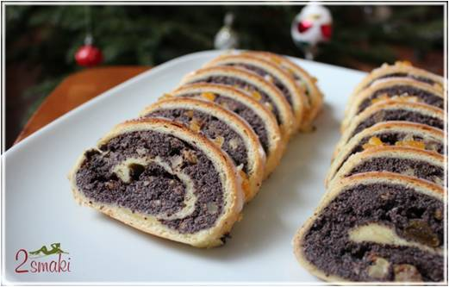
German food
Makowiec
Makowiec
Black tea
Black tea

Slide 9
DECORATION
- Little flags on the food : french, spanish,
polish, german
- The most popular buildings in our countries
- The food

Slide 10
Budget 1/2
INGREDIENTS | PRICE EUROS
sugar | 1,50
onion | 2
ground meat | 8,90
salt | 1
pepper | 2,50
apple juice | 12
sparkling water | 10
flour | 6
vanilla sugar | 2,50
eggs | 12
yeast | 3
poppy seed | 1

Slide 11
Budget 2/2
INGREDIENTS | PRICE EUROS
ham | 12
toothpicks | 3
oil | 6
garlic | 2
bread | 12
watermelon | 12
lemon
salmon
Ratatouille

