Slide 1
LONDON
Philip Geisberger

Slide 2
Our school was in London in October. We went on a bus early Monday morning. The journey took
us all day and night. We arrived at the French port of Calais. With the ferry we went through the La
Manche Canal.

Slide 3
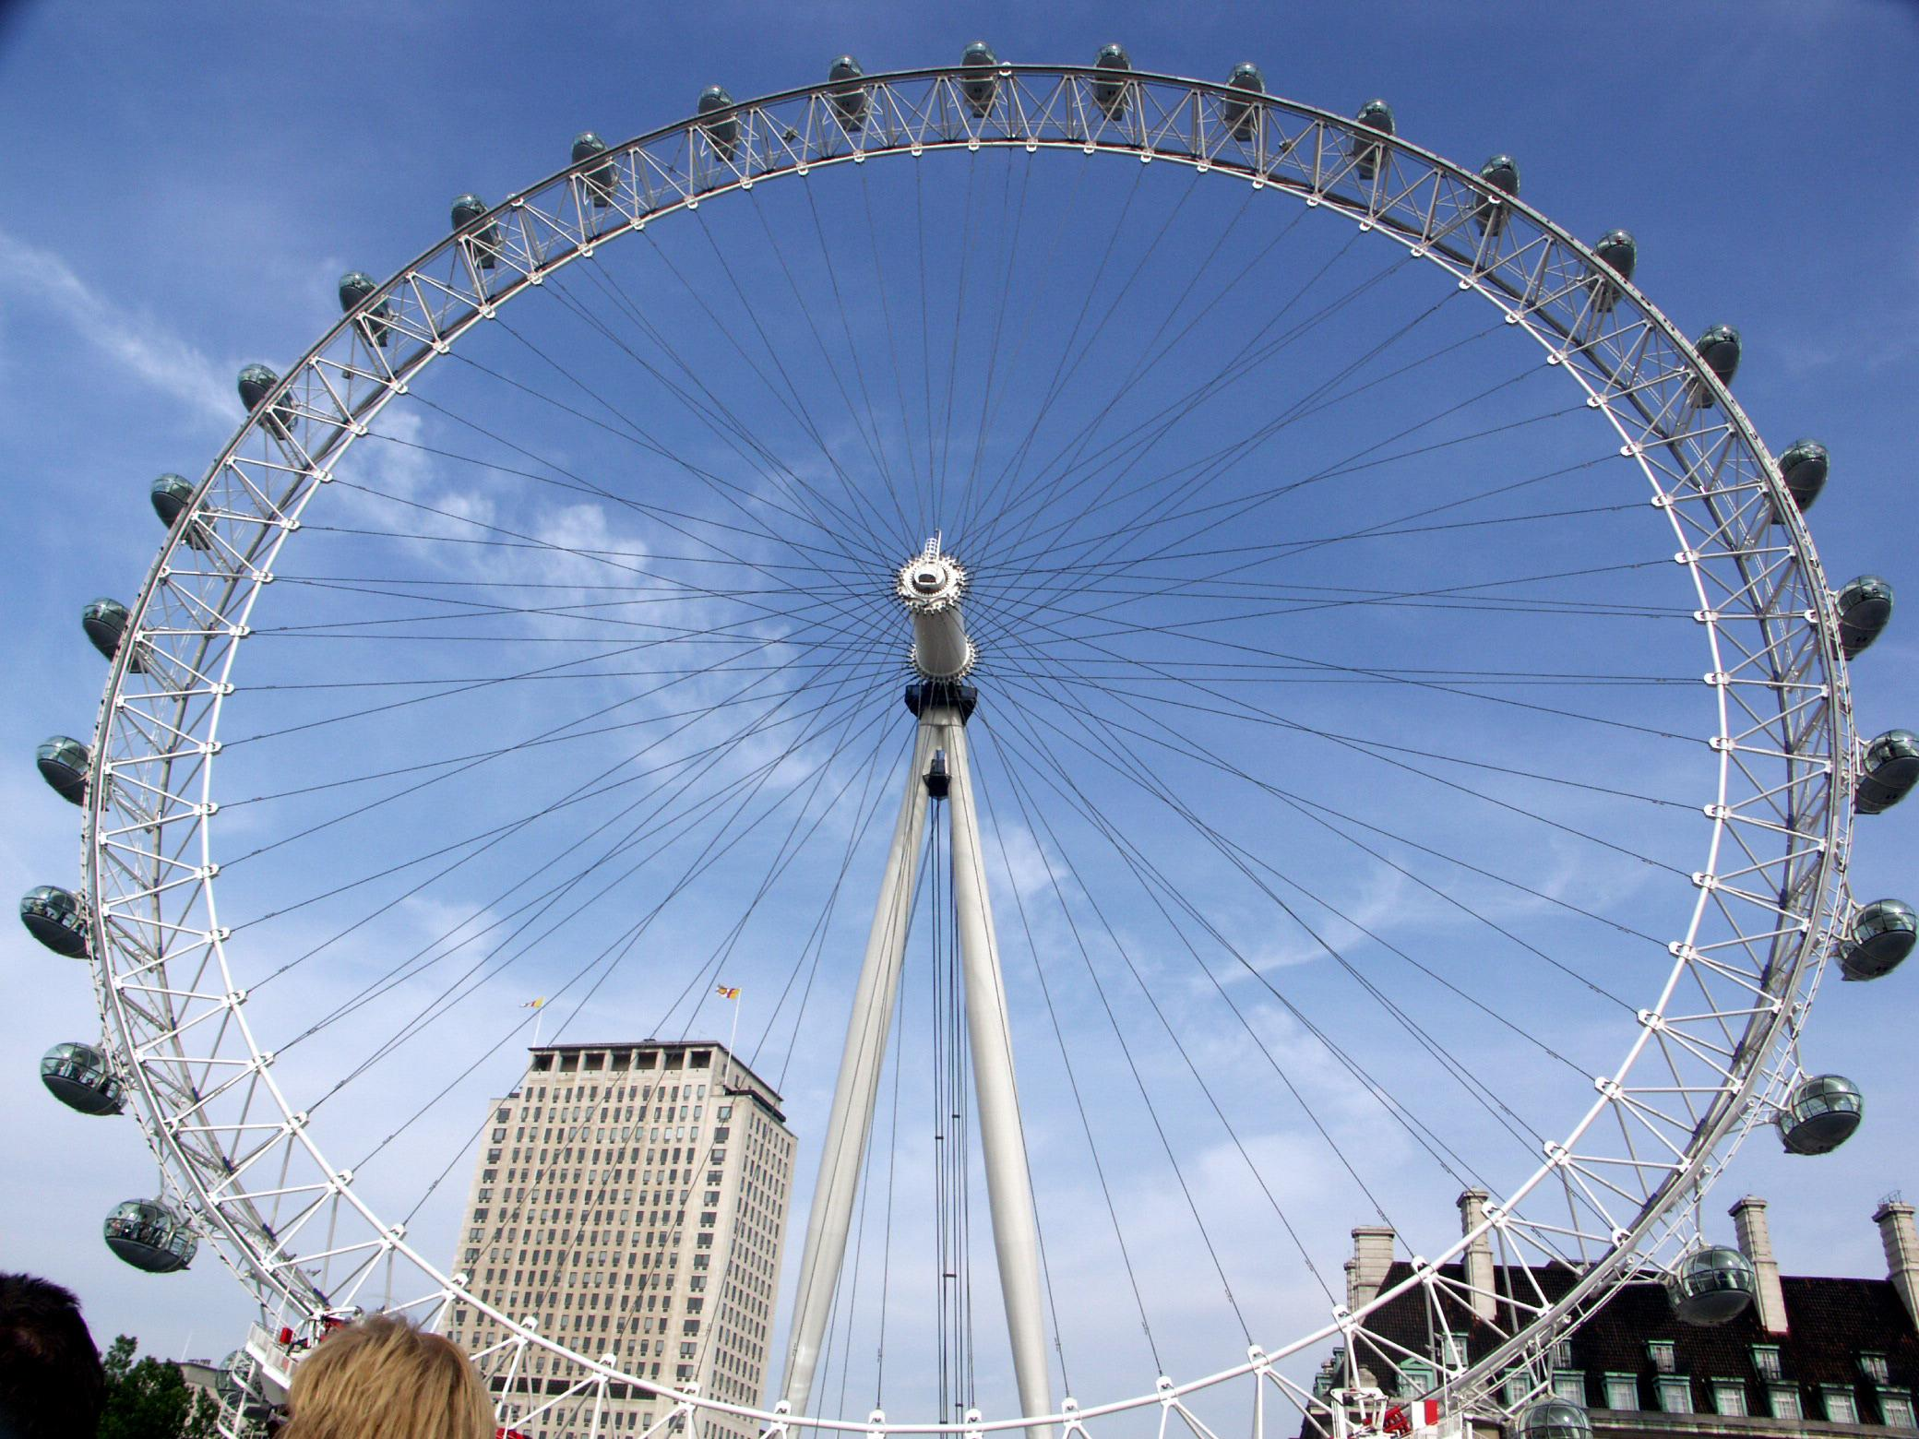
We visited the London Eye, Westminster
Abbey, Houses of Parliament, Big Ben,
Downing Street, Buckingham Palace,
China Town...

Slide 4
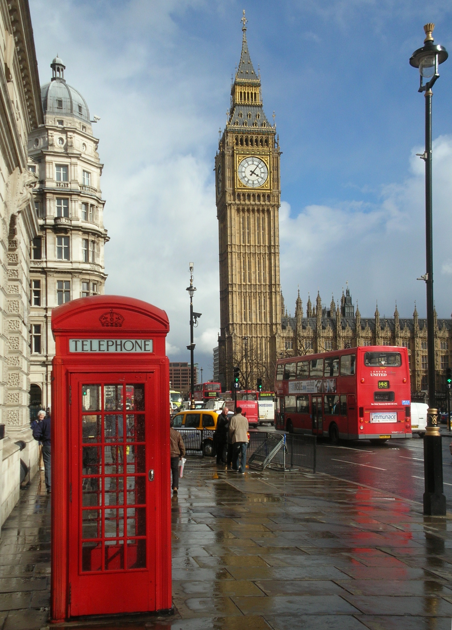
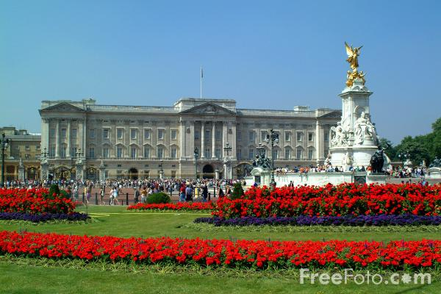

Slide 5
In the evening, we were living in an English family. We ate again and
went to visit the Natural History Museum, Science Museum, Hyde
Park. We went shopping to Oxford Street.

Slide 6
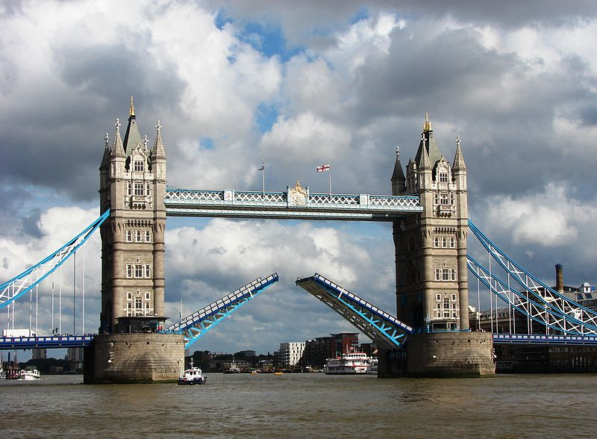
On the fourth day we visited the Museum of Madame Tussaud, St. Paul's Cathedral, Tower of London,
Tower Bridge. And in the evening we chose to go back home.

Slide 7
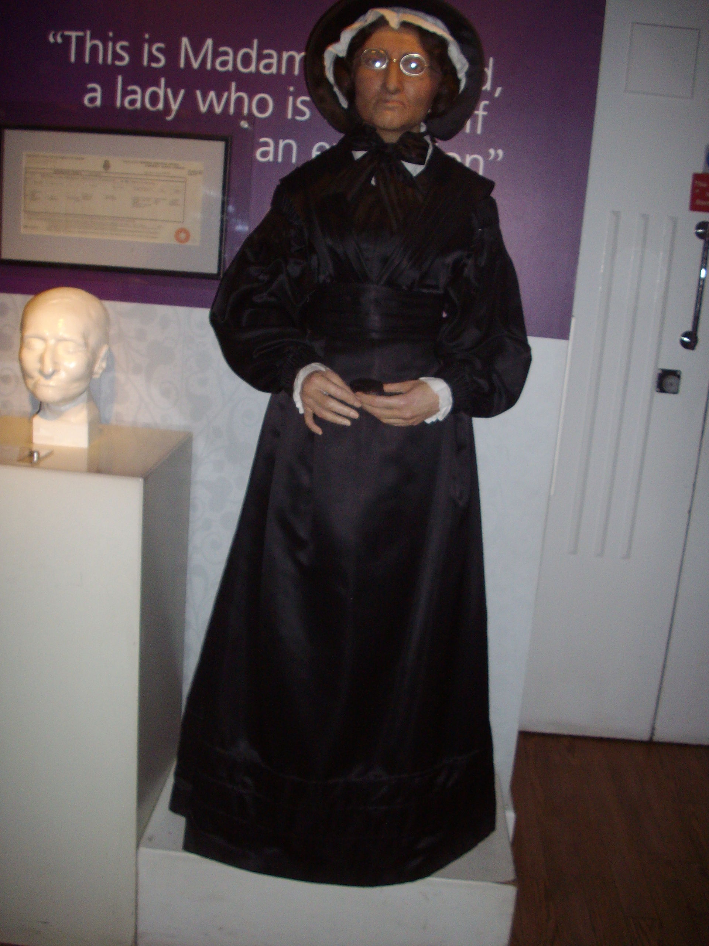
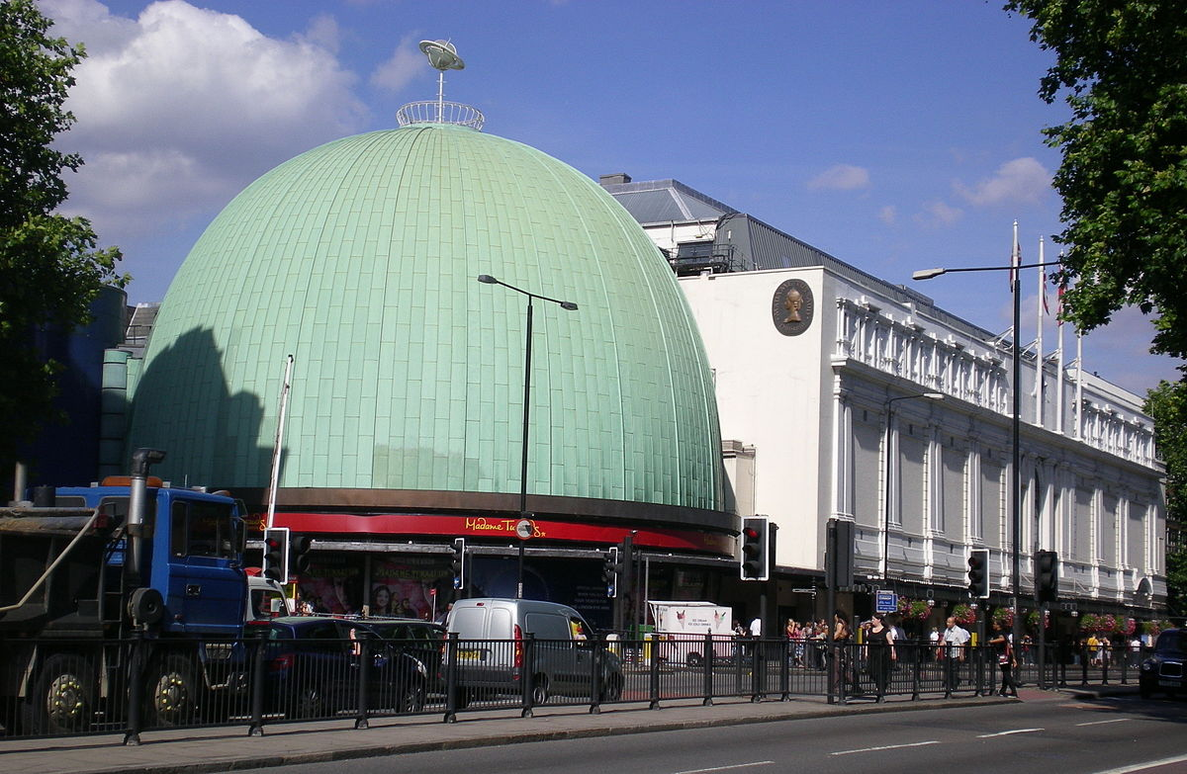

Slide 8
