Slide 1
Tomasz rygalik

Slide 2
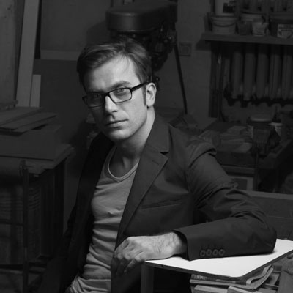
TOMEK RYGALIK (was born in 1976) is a leader of design studio at Warsaw Academy of Fine Arts. He studied architecture and city planning at Pratt Institue in New York. Over the period 2003-2005 he studied at Royal College of Art in London. He has design offices in London, Łódź and Warsaw.

Slide 3
Tomasz Rygalik is one of the most famous polish designers. He has a studio and lives in Warsaw, but he travels between Mediolan, London and New York. „I have everything except time” he says.

Slide 4
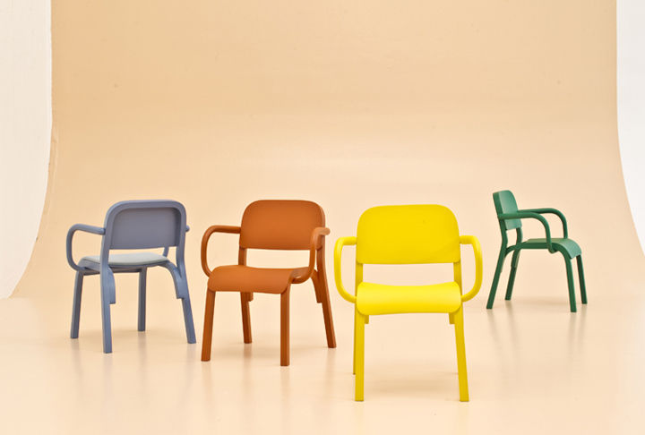
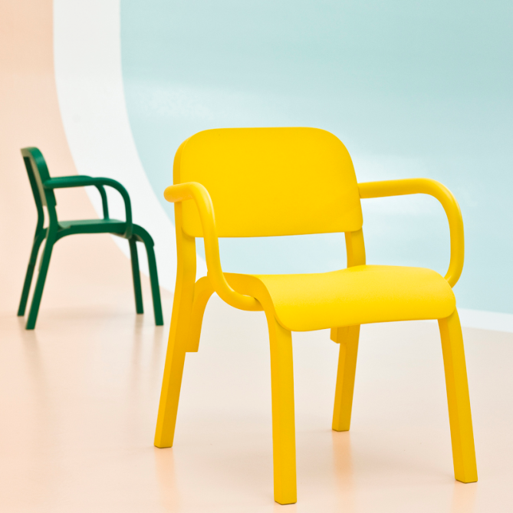
Designer has used traditional woodwork techniques: wood elements are construction, plywood is backrest and seat. Chairs are really colorfull and bright. This project was made in 2013 for Moroso brand.

Slide 5
Designed for Ikea nightable with lighting is another Rygalik’s project inspired by old Polish product. Unusual shape allows you to arrange your magazines, lay down your tea and charge your phone. This project works out well in small spaces.

Slide 6
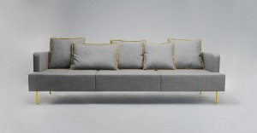
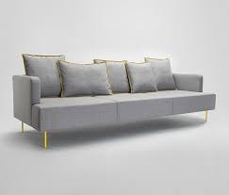
This couch looks like it is lifting above the ground due to thin steel legs. Levit couch fits in both public spaces and private living rooms.

Slide 7
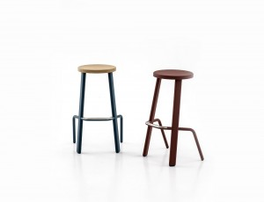
Made of steel and wood stools are available in different colour versions. These stools are handy and look amazing both in restaurants and kitchens at home.

Slide 8
Thank you for your attention!

