Slide 1
Code.org tutorial

Slide 2
Step 1
Click this link: https://studio.code.org/projects/playlab/imIhUzjFgJMpXtVArTDD1zeAOGRVwuMKO5coUmtbjsU/view
Then click the remix button.

Slide 3
Step 2 : Assigning a character to an image
To assign an image to a character use this command. This will make it that your character will be visible when you run game.
You can also set a background . We will be setting the soccer background as our character is a soccer boy.

Slide 4
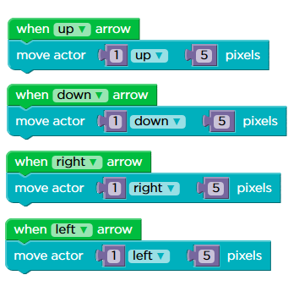
Step 3 : Character movement
This is how you make your character move.

Slide 5
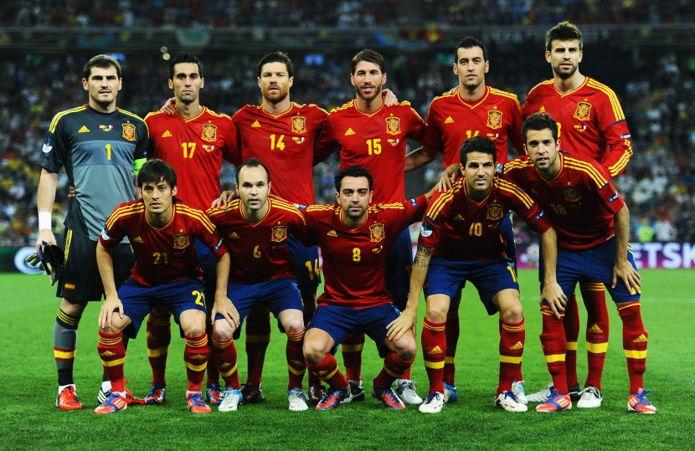
Step 4 : Game Objective
Try to think about what you want your game to be about. We chose a soccer game.

Slide 6
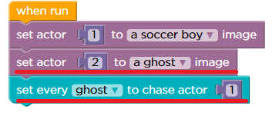
Step 5 : Artificial Intelligence
You can make some simple artificial intelligence characters in this code.
You can make a ghost follow the character.

Slide 7
Good job! You did it.
Click here to see our game and the code.
https://studio.code.org/projects/playlab/8EmPKFm53u3CRh44HQ0EAnd3MiG_y0zvFZ9Vo40NVxE

