Slide 2
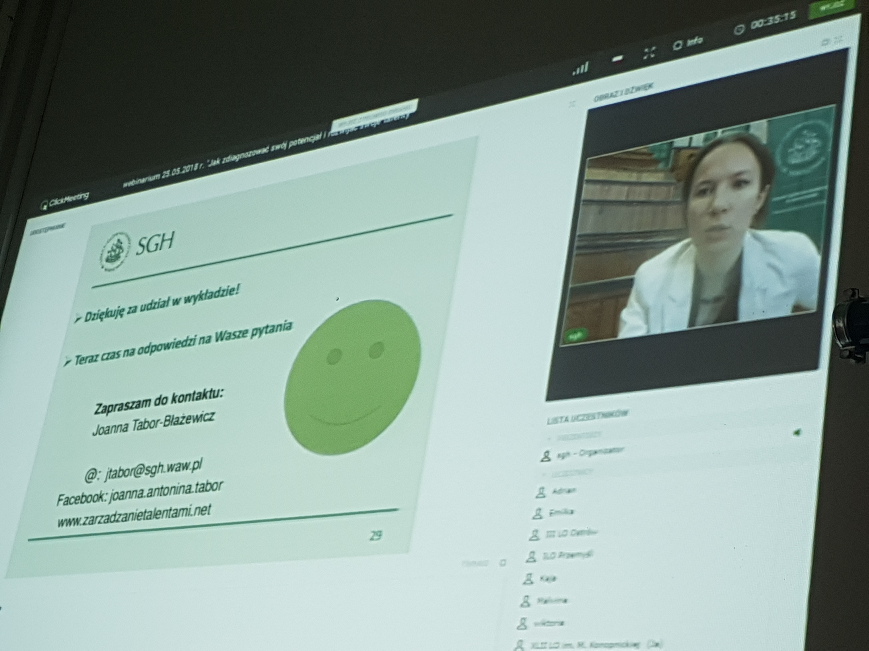
how to assess your potential and discover your talents? The webinar by Joanna Tabor-Błażewicz

Slide 3
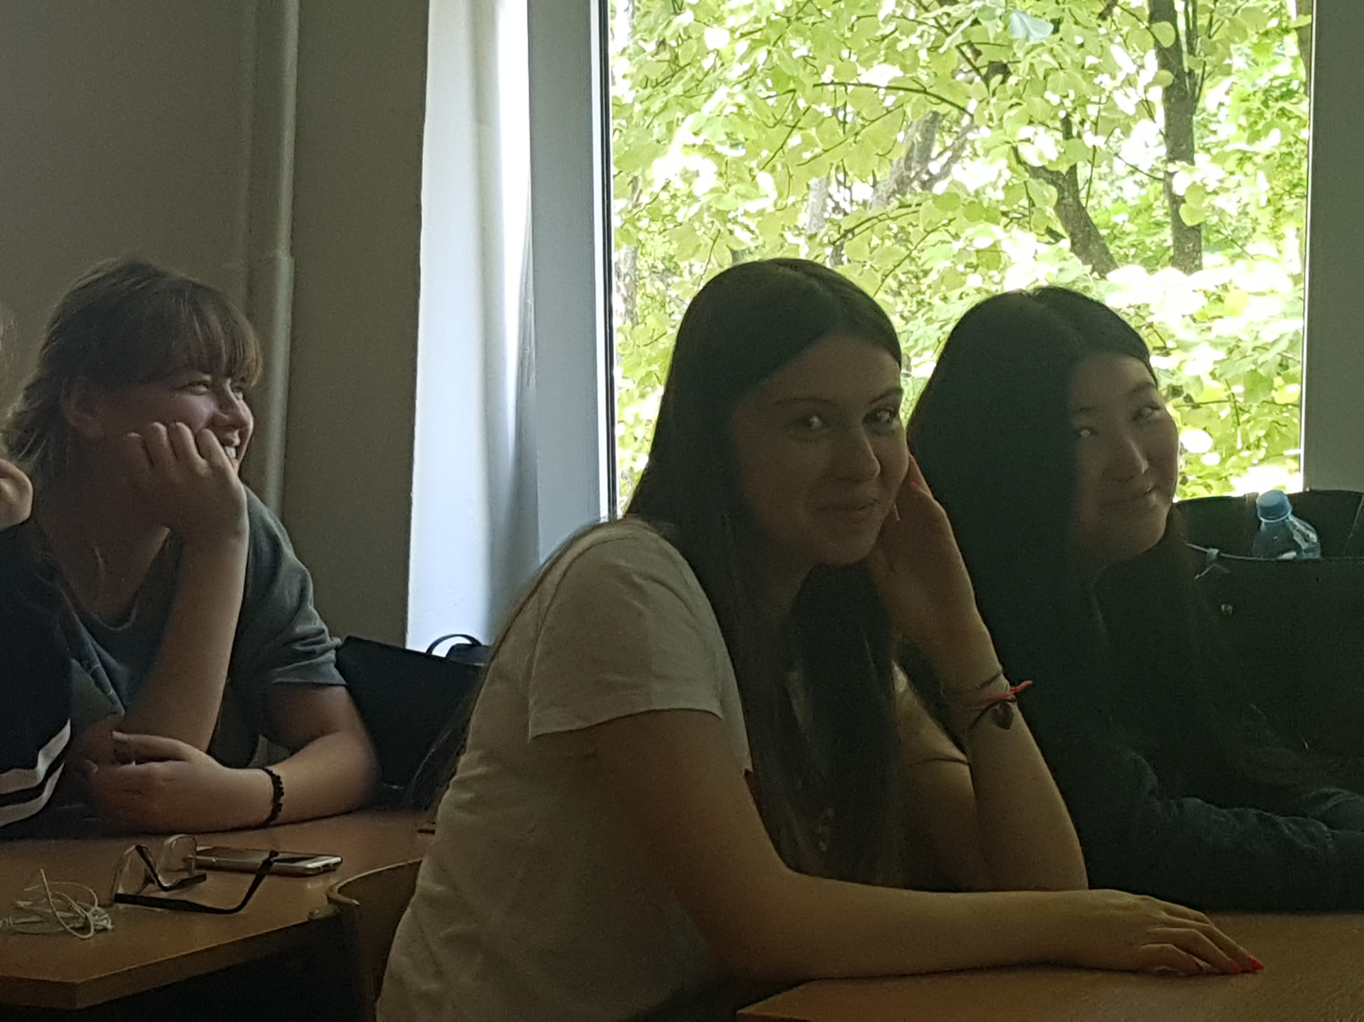
We took part in the webinar conducted by Joanna tabor-Błażewicz, a leturer at warsaw school of economics. the topic of the seminar was strictly connected with the Erasmus+ project-Creating and developing your future. The webinar’s aim was to teach us how to assess our potential, discover our talents and skills and how to make the best use of tchem.

Slide 4
how to assess a potential of an employee?
abilities
health
a general and professional knowledge
practical skills
a level of moralities
motivation

Slide 5
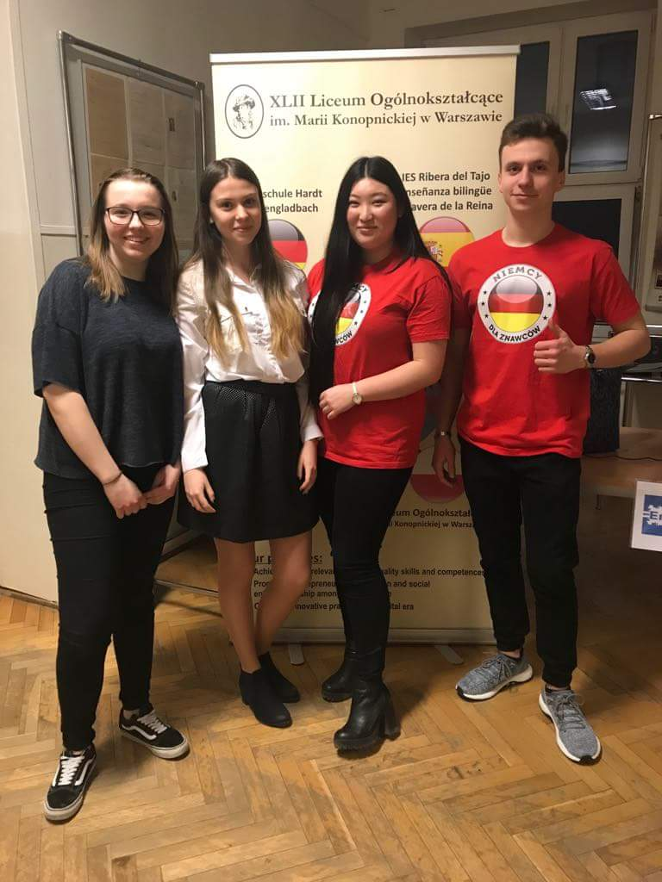
Who are HiPO?
HIGH POTENTIALS – very talented employees,
the rising stars who are the key employees
in a company or an organisation.

Slide 6
The qualities of hipos:
they are good at what they do
they jump on leadership opportunities
they work autonomously and they work well in group setttings
they take initiative
they are interested in where the company is going
they do not buckle under pressure
they ask questions
they continually develop their skills
they help their coworkers when they can, they are trusted by their peers and they possess a high level of emotional intelligence
they take on responsibilities outside of their work description
they recognise their coworkers’ hard job
they listen to feedback
they let their goals be known

Slide 7
Benefits of potential’s assessment
getting to know employees better
making them highly-motivated and more engaged
increasing and sustaining high productivity
understanding how to best develop talents
significant insight into organisation

Slide 8
What is a talent?
natural aptitude or skill
a former weight and a unit of currency, used especially
by the ancients Roamans and Greeks

Slide 9
10 ways to identify your talents
take a personality test
find what makes you feel strong
find what you spend the most money on
ask your friens what your best and worst qualities are
ask your family what you loved as a child
write in a journal
look for talent in others
take stock of your books/music/movies collection
remember what you have been thanked for
be open to change

Slide 10
Try to assess your potential☺
Try to assess your potential. Make a short list of your competences/skills/talents and write them down.
Take into consideration the following aspects:
interests/hobbies
the projects you have already taken part in
the features of your character and personality
IT and computer skills
the language skills

Slide 11
Thank you for your attention☺

