Slide 1
London
Klára Martinková
Táňa Malinkovičová
IX.A
2018/2019

Slide 2
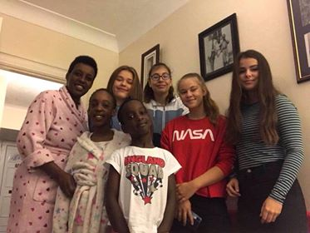
The host family
There were parents with three children in the family.
The parents work as an accountant and a lawyer.
We lived in a bungalow in Croydon.
They had quite a big house, in which we had breakfast, dinner and in which we slept in.
They were lovely and we could rely on them.

Slide 3
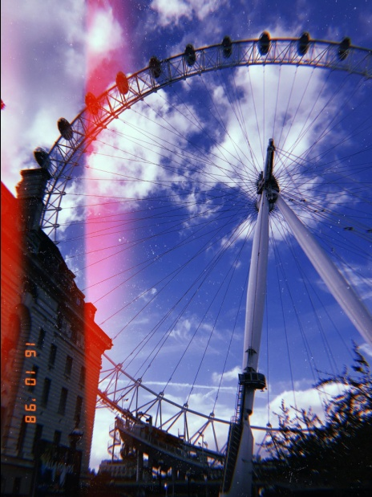
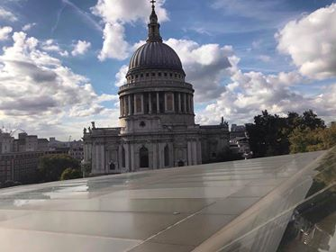
Monuments
During our visit in London we ... well visited lots of beautiful monuments. Here are a few examples:
The London Eye- is a giant Ferris wheel on the South Bank of the River Thames in London. This giant wheel is 135 meters tall, that is about 480 coca cola bottles tall.
St. Paul’s Cathedral- is an Anglican cathedral, the seat of the Bishop of London and the mother church of the Diocese of London, in other words a really beautiful church and a masterpiece. We had a chance to explore Whispering gallery, Stone gallery and also Golden gallery and a lot more. Oh, man. Do these people love galleries.

Slide 4
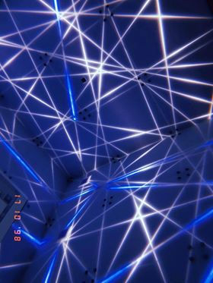
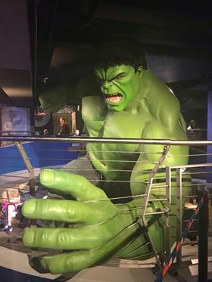
Science museum- we visited 2 museums during our London adventure: natural history museum and science museum. We liked the science one more. What we liked about it? Well, for us it was more interesting not only because it is something that we do not learn in school, but also we admired the models and shop.
Madame Tussauds-is a wax museum in London. We liked this museum the most compared to other museums or monuments. We liked that it had more than one theme like Sherlock´s alley or our favorite president. And thanks to this museum we could take a selfies with celebrities known all over the world.

Slide 5
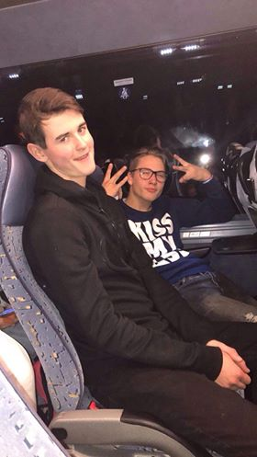
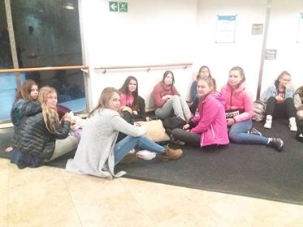
Journey
We travelled by bus and ferry.
We travelled about 27 hours including breaks.
We went from Slovakia through Czech republic, Germany, Belgium, France to London.
We travelled with our teachers, bus drivers and guide.
Most of the time we were sleeping, talking or watching a movies.
From France we travelled by ferry for an hour and a half and then again by bus.

Slide 6
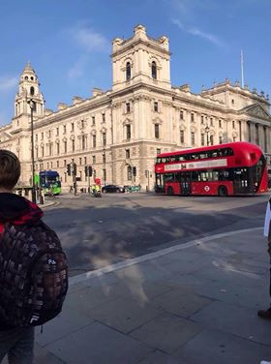
Traveling in London
We travelled by double-decker and tube.
Double-decker buses are used for transport in the United Kingdom.They are famous for the red colour and the fact that the bus has two storeys or decks.
The London Underground (also known simply as the Underground, or by its nickname the Tube) is the way of transport underground. Most of the people use it, because it is a fast and cheap way to travel anywhere in London.

Slide 7
How do we rate:
The guide-she got to the point, patient and we liked her, because she was full of optimism.
The bus drivers-they were awesome, they smiled A LOT and they made pretty good sausages.
Monuments- our guide did an amazing job in choosing the monuments. We went to the most important ones. We liked them.
Family-we loved the family. They were nice, friendly and they were willing to help and the cherry on top was the best meal we could experience.
Journey-was long, but we gained lots of memories.

Slide 8
Thank you for your attention !!!

