Slide 2
Why is marketing important?
It is the way to advertise the company
It is the way to become popular
It is the way to reach a lot of people

Slide 3
How to make a good advertisement?

Slide 4
It must be easy to understand

Slide 5
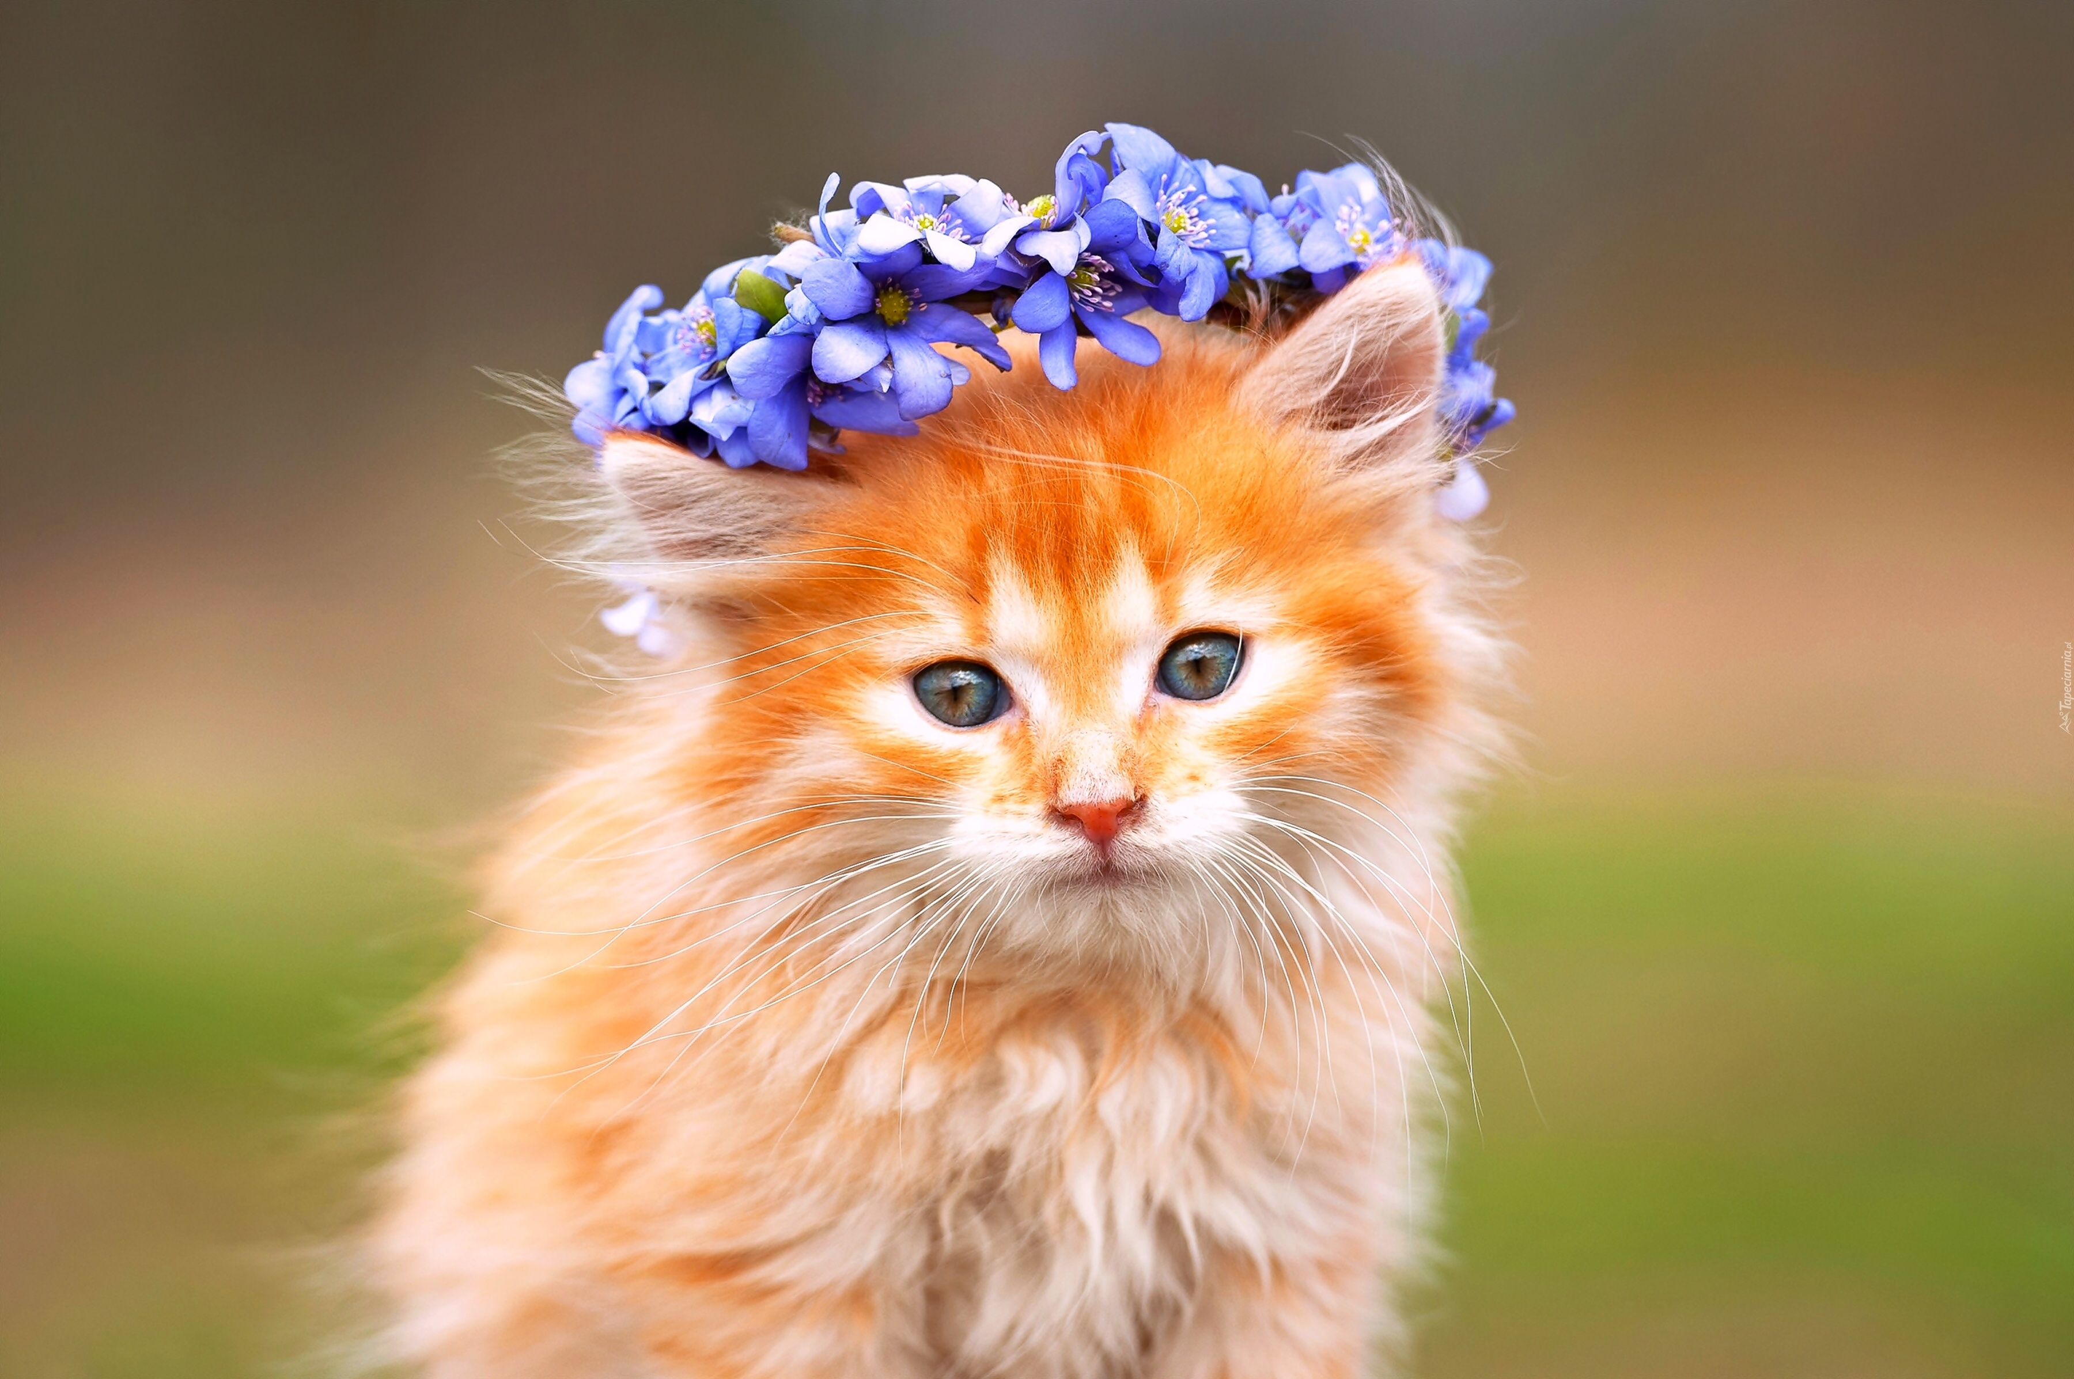
It should be interesting

Slide 6
It should be colorful

Slide 7
Characters should be “normal” people as we are

Slide 8
Who works on the advertisement?
Video team recording the advertisement
Psychologists who do the research
Marketing specialists who create the advertisement step by step (dialogue, music, scenery etc.)

Slide 9
Coca-Cola company advertisement

Slide 10
The goal is to become familiar for everyone

Slide 11
The product is present in every house and every situation

Slide 12
Music is a perfect background

Slide 13
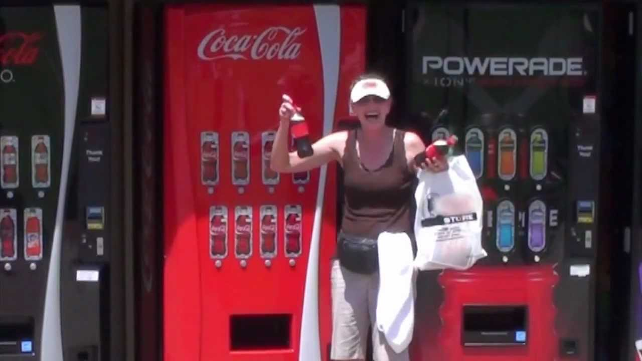
It reminds about happy moments

Slide 14
Conclusion: The Coca-Cola company became so popular around the world that they don’t need the advertisement anymore, but they are still doing it. WHY?

